Slide 1
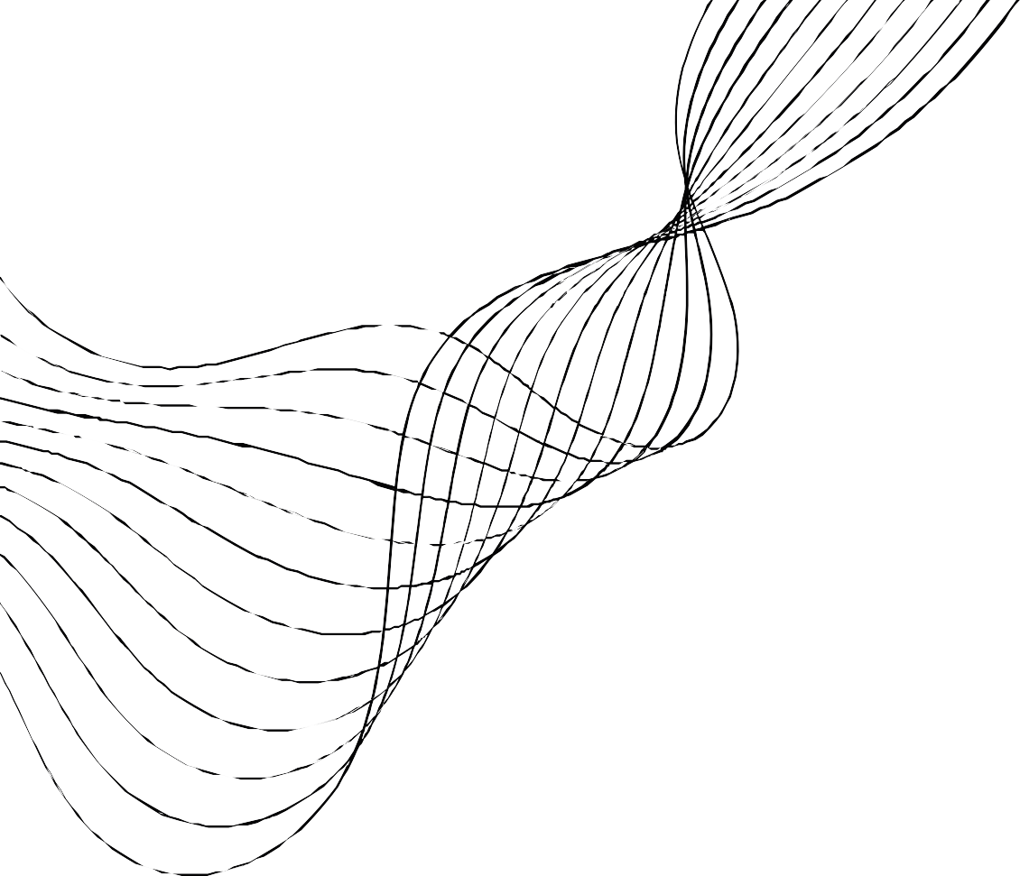

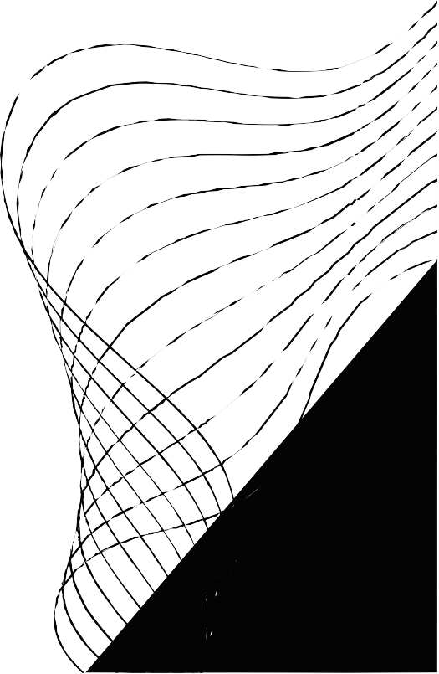
OPTIMUS PRIME
YOUR ONE- STOP SOURCE FOR WELLNESS INFORMATION AND ONLINE
CONSULTATIONS
BY AASHISH

Slide 2
CONCEPTS
Implemented
•Used Component Hierarchy
•Used services
•Used pipes
•For UI components, used angular material
•Data maintained in Json-server API
•Used Routing parameters
•Implemented Lazy loading
•Used both Template based & Model based approach
•Implemented Multiple user flow
•Effective handling of multiple modules
•Complex feature implementation
Not Implemented
•Internilization
•Security implementation
•Custom directives

Slide 3


USER FLOW
USER COMPONENT
HOME
TESTIMONIALS
DISEASES
TALK TO DOCTOR

Slide 4
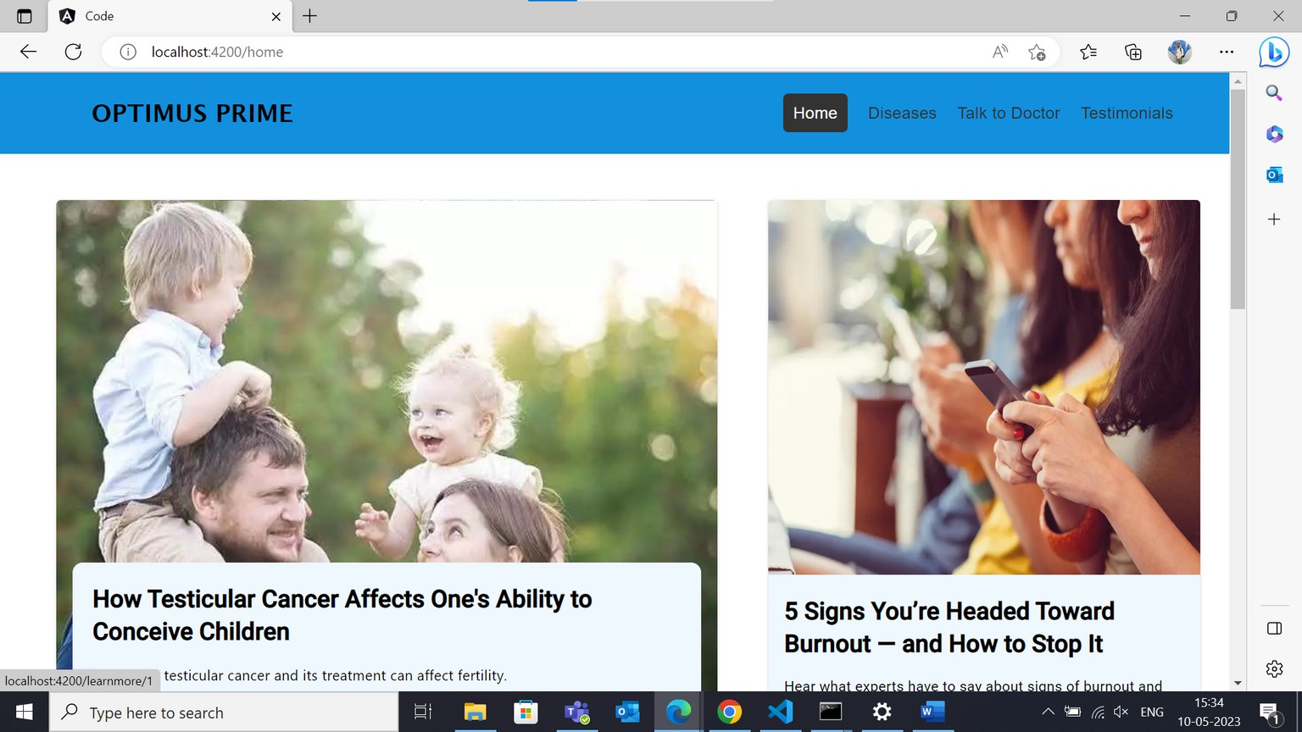



USER/ HOME PAGE
Things Used:
Menu bar using mat- toolbar
Articles using mat- card and i f click redirect to
learn more component
there details of the articles are there, these are
connected to router l ink.
Enquiry box : templet
based form , which have validators and i t will post to json server using
service.

Slide 5
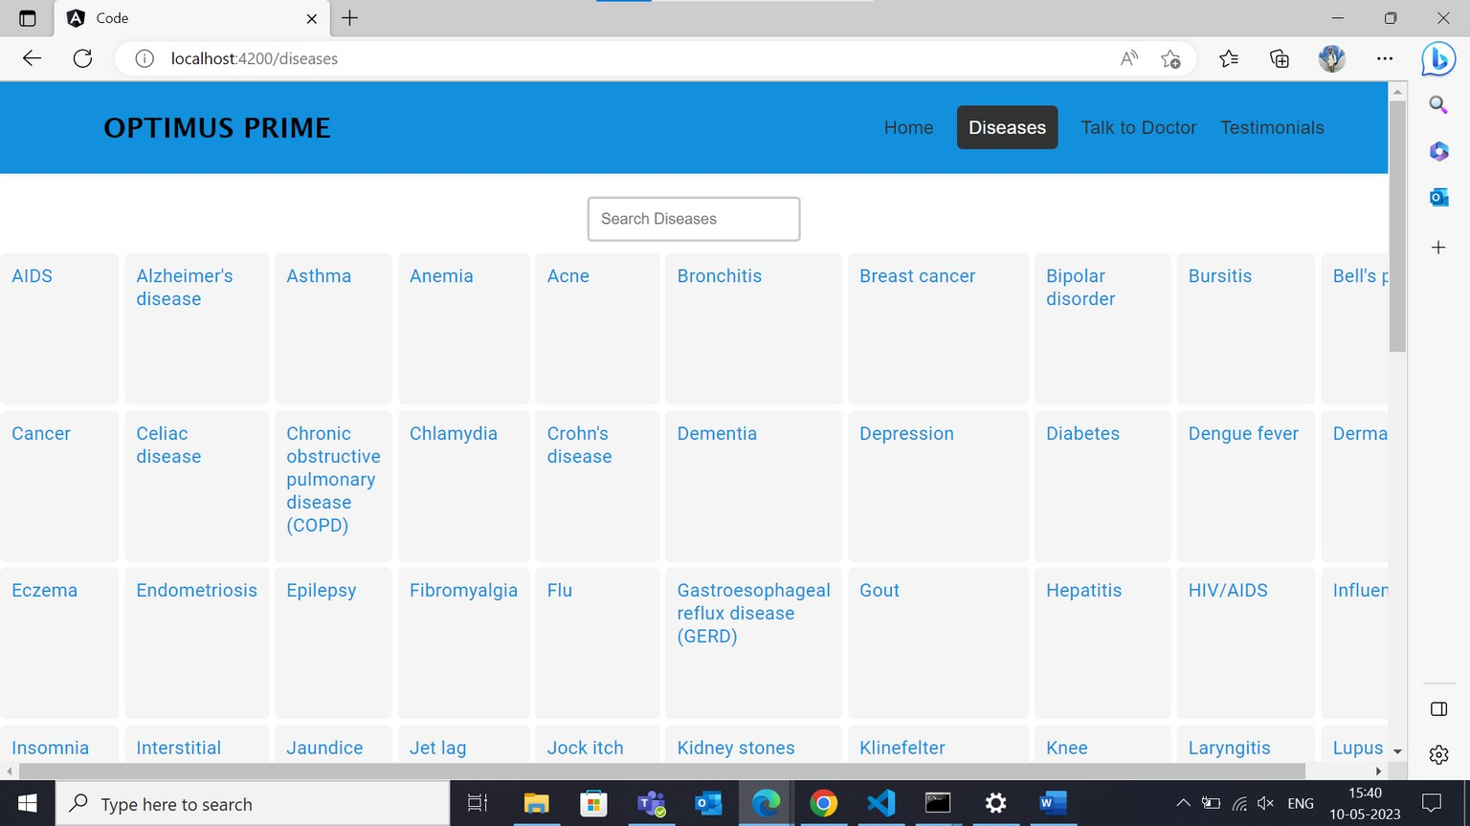

USER/ DISEASES PAGE
Things Used:
Menu bar using mat- toolbar
Disease name component which gets all the names of the diseases in the server.
when clicked it will go to diseases details component where the details are get form the server using services
And a search bar to search the to filter the diseases names using filter

Slide 6
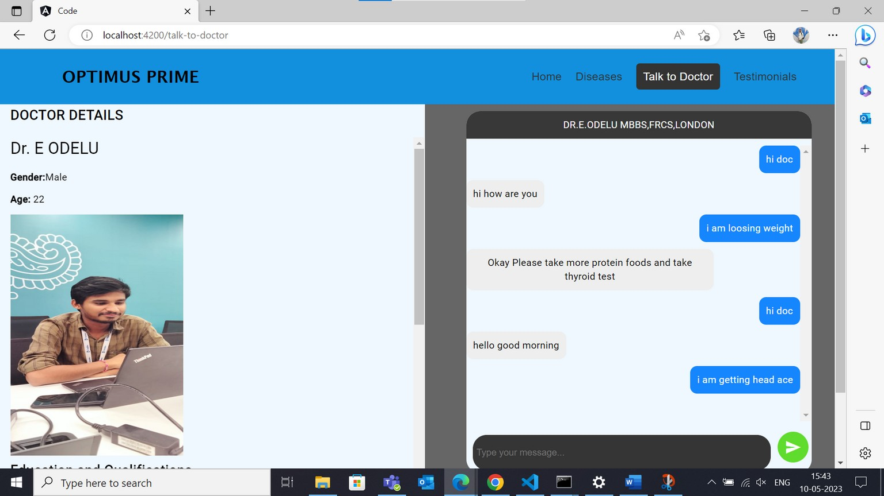

USER/ TALK TO PATIENT
Things Used:
Menu- bar using mat-
toolbar doctor details. chat- box which uses
services to get and post information.
this is a communication
center for admin and user modules
for user admin messages are r ight side and user' s a left and vice versa for
admin
send button to send the message to server.

Slide 7
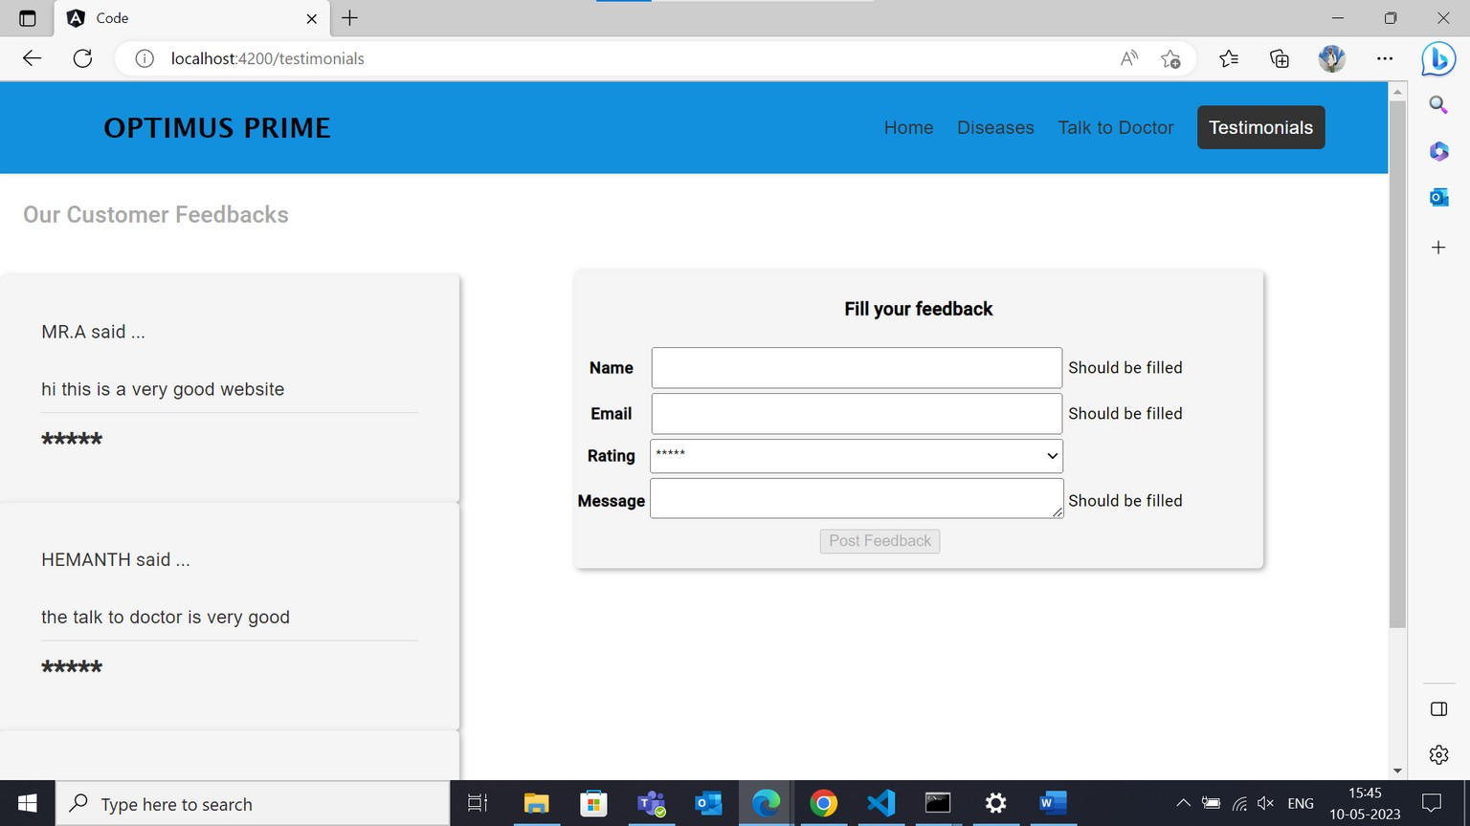

USER/ TESTIMONIALS
Things used:
mat- toolbar to show menu bar.
mat card to display the reviews
and a model based
form to send review to the server
here we use post service and get
service

Slide 8
ADMIN FLOW
ADMIN COMPONENT
ADD DISEASES
TALK TO PATIENT

Slide 9
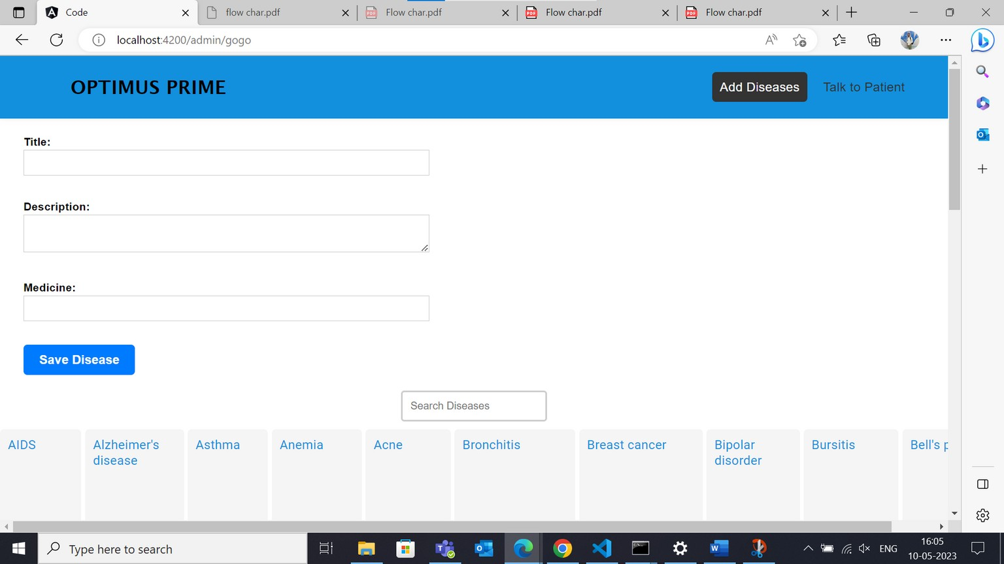
ADMIN/ ADD DISEASES
Things used:
Menu bar: Mat toolbar
Simple form: To add the
diseases with validators
Diseases names component

Slide 10
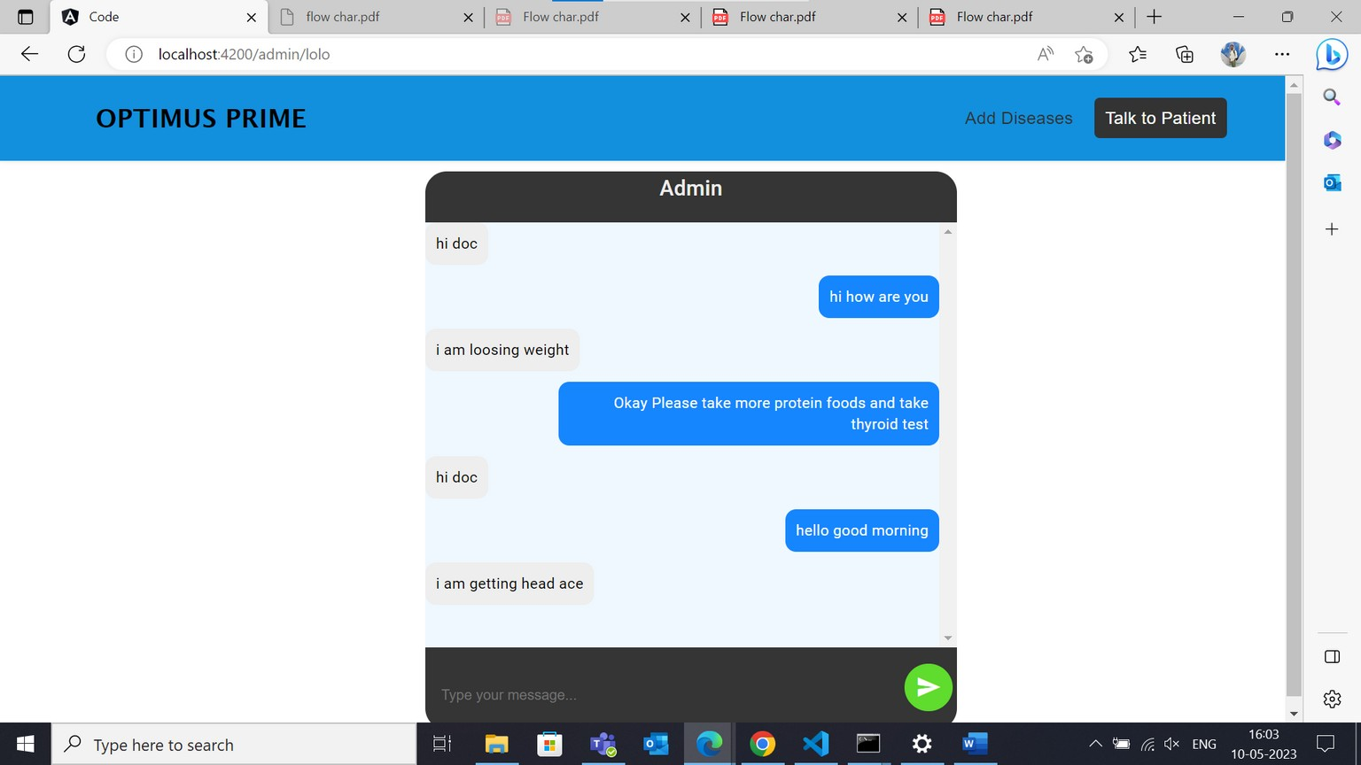
ADMIN/ TALK TO PATIENT
Things used:
chat- box which uses get and
post services
where patient messages are left side and
doctor message is r ight side.

Slide 11


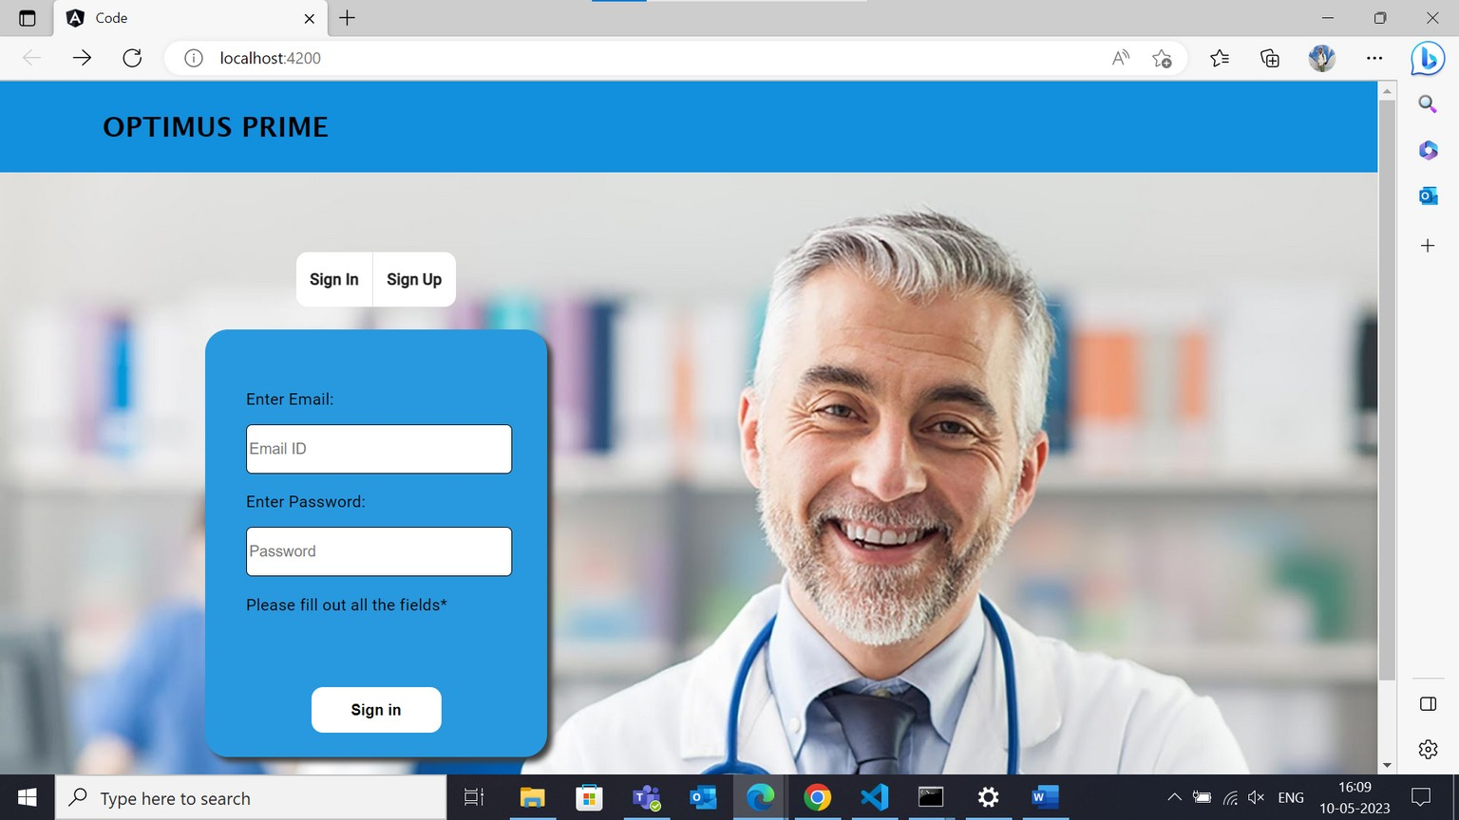
LOGIN
Things used:
mat card
mat content
model based form with validators
signup and sign in toggle button
sign button
after form is validated i t will navigate to
admin module and user according to password.

Slide 12
THANK' S FOR WATCHING

